Slide 1
E-Commerce
Team 5

Slide 2
Team 5 Introductions
Dominic, Justin, Raheleh, Louis

Slide 3

Technologies Used...
Spring Boot
Maven
React.Js
MySQL
2 external APIs
Rates
Fake Store
And last but not least…
Slack & ZOOM!

Slide 4
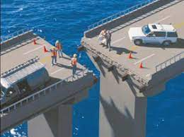
What we worked on
Dominic:
Service Layer, Entities, Daos, Tests, SQL DDL and DML, React
Justin:
Store and Login pages, Entities, Daos, Tests, ERD, DDL
Raheleh:
Report and Purchase History pages, Live Exchange Rate, Daos,
Louis:
Entities, DAOs, Tests, Controller, Cart Page, Connecting Axios. SQL

Slide 5
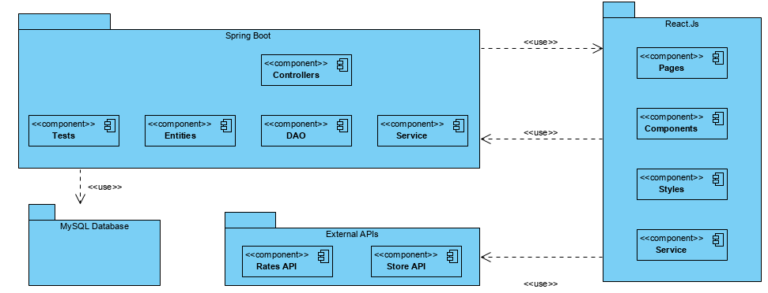
Architecture

Slide 6
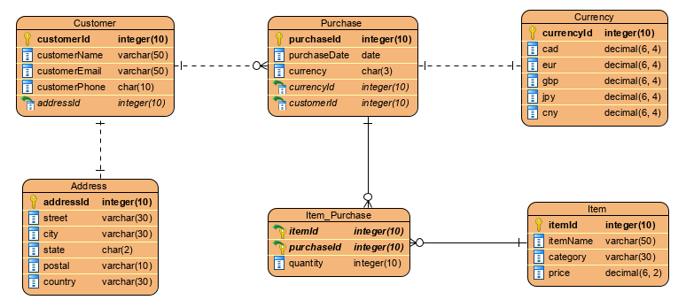
ERD

Slide 7

Time for the Project Demo!!

Slide 8

Lessons Learned...
How to connect React to Spring Boot
How to efficiently store information into JSON
Use ‘filter’ to filter state’s data in React for our report page
Overhead of making sure all our parts can actually work together

Slide 9


Do you have any questions?

